Slide 1
Converting Data Between Wide and Long Format in R
Jing Feng
Sr. Institutional Researcher, Office of Institutional Analytics
April 26th, 2024

Slide 2
Wide vs. Long Format
Wide format: values do not repeat in the first column.
Long format: values repeat in the first column.
Campus | 2023 | 2022
Main
Gallup
Los Alamos
Valencia
Taos
Campus | Year | Enrollment
Main | 2023
Main | 2022
Gallup | 2023
Gallup | 2022
… | …

Slide 3
Long to wide conversion – method 1
spread() from the tidyr package
wide_data <- long_data %>%
spread("key", "value")

Slide 4
Long to wide conversion – method 2
dcast() from the reshape2 package
wide_data <- long_data %>%
dcast(x ~ y, value.var=“value“)

Slide 5
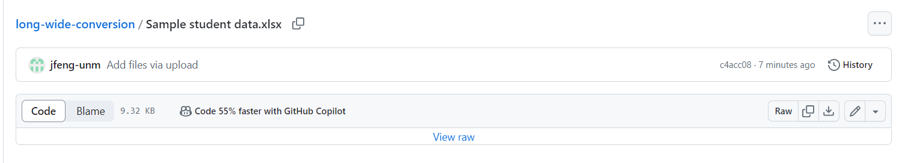
Demo/Exercise
Download Sample student data.xlsx here (either URL is okay):
https://github.com/jfeng-unm/long-wide-conversion
https://tinyurl.com/long-wide
Click on the file name, and then click on the download icon

Slide 6
Demo/Exercise
Save the Excel file on your computer, and import the first sheet (“SCH”) in R
Convert it from long to wide format using either spread() or dcast()
Each semester value should be its own column

Slide 7
Wide to long conversion – method 1
gather() from the tidyr package
long_data <- wide_data %>% gather("key", "value", x, y, z)
“key” and “value” are names of the new key and value columns
x, y, z are the columns to be “gathered”

Slide 8
Wide to long conversion – method 2
melt() from the reshape2 package
long_data <- wide_data %>%
melt(id.vars = c(“a”, “b”),
measure.vars = c(“c”, “d”),
variable.name = “x”,
value.name = “y”)

Slide 9
Demo/Exercise
Convert the table in wide format you got in the previous exercise back to long format

Slide 10
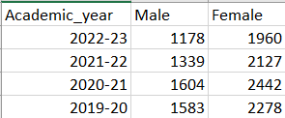

Exercise
From the Excel file you downloaded earlier, import the second sheet (“Grads”) in R
Use long/wide conversions to transpose the table:

Slide 11
Resources
Tutorial with examples: http://www.cookbook-r.com/Manipulating_data/Converting_data_between_wide_and_long_format/
GitHub repo with R code and data file: https://github.com/jfeng-unm/long-wide-conversion
My email: jingfeng@unm.edu

Slide 12
Thank You
Questions?

